Slide 1
“SMOKE DETECTION WITH FIRE PREVENTION USING CISCO PACKET TRACER ”
Mini Project
Divya Shree R 1NH18EC711
Devika K 1NH18EC130
Sahana Yelchuri 1NH18EC131
Sharanya K.N 1NH18EC747
Guided By
Mr. Karthik C V
Assistant Professor
Dept. of ECE
New Horizon College of Engineering, Bengaluru

Slide 2
Contents
Introduction
Literature Review
Existing System
Problem Statement & Objectives
Proposed System
Block Diagram
Hardware & Software Specification
Circuit Diagram & Working
Results & Discussion
Advantages
Conclusion & Future Scope
References
Progress Work
Milestones/Schedule

Slide 3
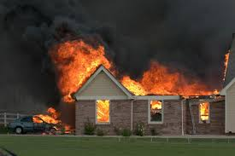
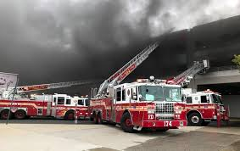
Introduction
The technology has been growing from day to day in human life. The necessity for the development of technology is to lead human life comfortably.
This project gives the basic idea on fire detection and prevention. This project is achieved by simulation via network setup and wireless home gateway computer network equipment required by a smart home network cisco packet tracer using Internet Thing (IoT)/IoE command.
The software chosen for the simulations is Cisco Packet Tracer, the tool's main strength is to offer a variety of network components that represent a real network, and then interconnect and configure devices to create a network. Cisco implemented (IoT) functionalities in the latest version of the platform, and now it is possible to add all the smart devices, sensors, actuators and also devices, which simulate microcontrollers like Arduino or Raspberry Pi to the network. All IoT devices can be run on generic programs or modified by Java, Python or Blocky programming them. This makes Cisco Packet Tracer a perfect method to construct functional simulations for IoT. Index Terms : Internet of Everything, Smart home, packet tracer tool, sensors.

Slide 4
Literature Review
Title of the paper | Author & Year of Publication | Outcome
1 2 | The ISC Int'l Journal of Information Security, (ISEECURE), ‎2009 www.wikipedia.org/wiki/computer_networks, Retrieved 10th October, 2016. [4] Tim Reardon, Planning, Designing and operating local area networks, DISAM Journal, Summer, 1997 | In this paper, we used the Packet Tracer tools to build a smart home and applying a wireless connection between a smartphone and important and famous IoT devices Networking connections, connectivity and home automation(IOT)

Slide 5
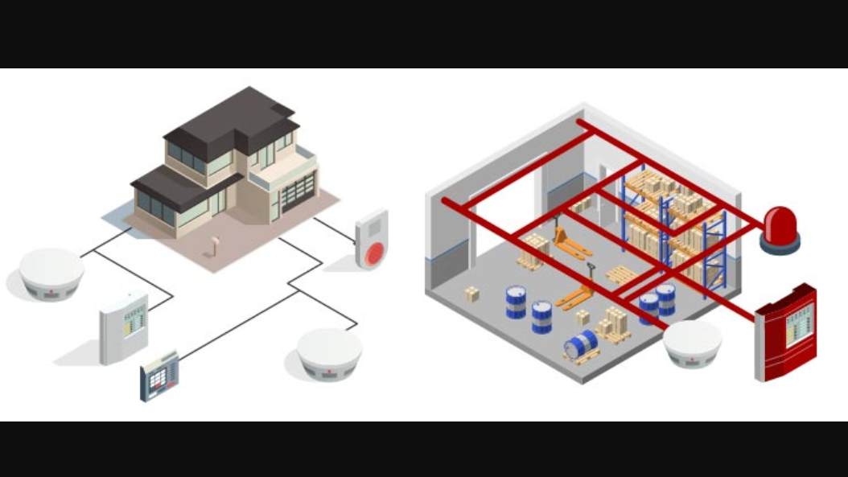
Existing System

Slide 6
Problem Statement & Objectives
Problem Statement : It has been found in a survey that 80% losses caused due to fire would have been kept away from if the fire was identified promptly. So detecting small intensities of smoke, at a initial stage is the need of the hour .
Objectives:
To detect fire in very early stage of it’s form.
To alert any personnel at location of the fire event so that they are aware and could take any necessary action.
To activate the fire fighting equipment.

Slide 7
Proposed System
This fire detection and prevention system is simulated using cisco packet tracer because it allows us to simulate different types of network virtually. Especially, wireless networks and Internet Of Things(IoT) devices.
In this software, IoT devices like garage door, smart phone, window, door, smoke detector , siren and fire sprinkler appear as they are in reality, and users can monitor and interact with these wireless IoT devices for updates.
Home Gateway are used for connecting inner network to outer network or connecting LAN to internet. (DLC-100)

Slide 8
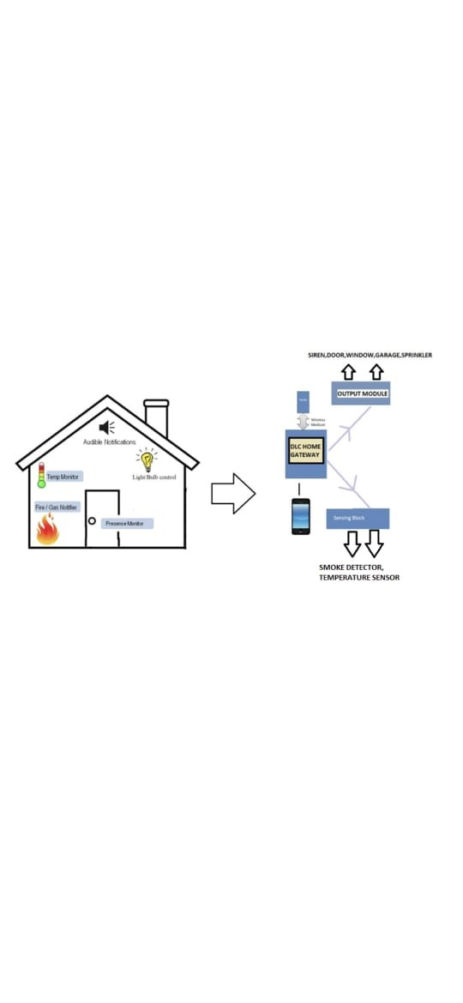
Block Diagram

Slide 9




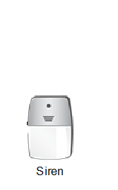

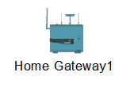



Hardware & Software Specification
Smoke Sensor 6. Window
2. Door 7. Old car
3. Siren 8. Fire sprinkler
4.Garage Door 9. Home Gateway
6. MCU Board
10. Temperature Sensor

Slide 10
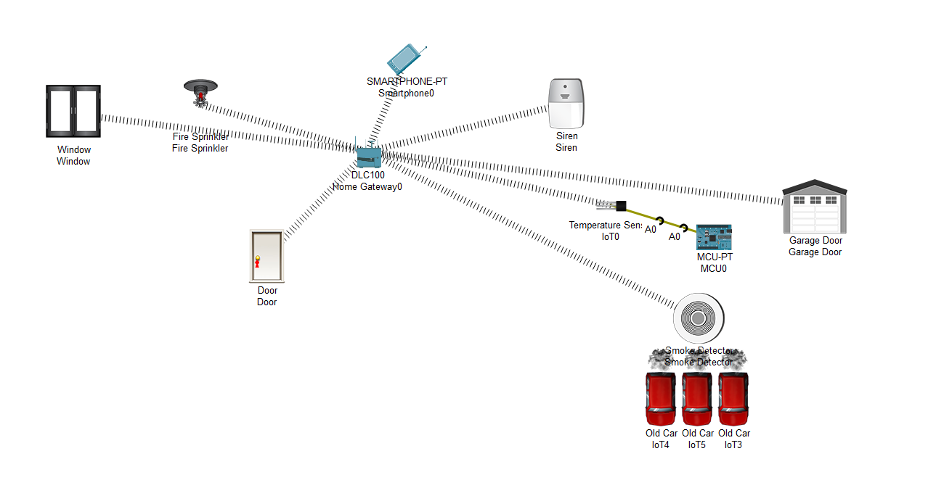
Circuit Diagram

Slide 11
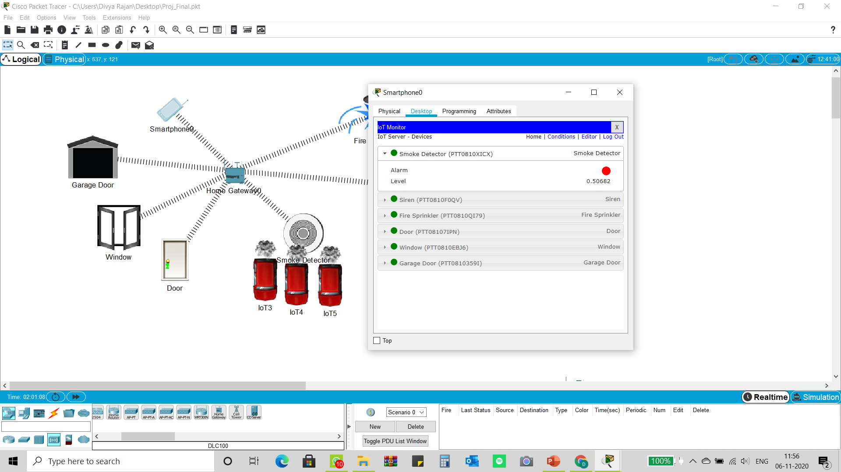
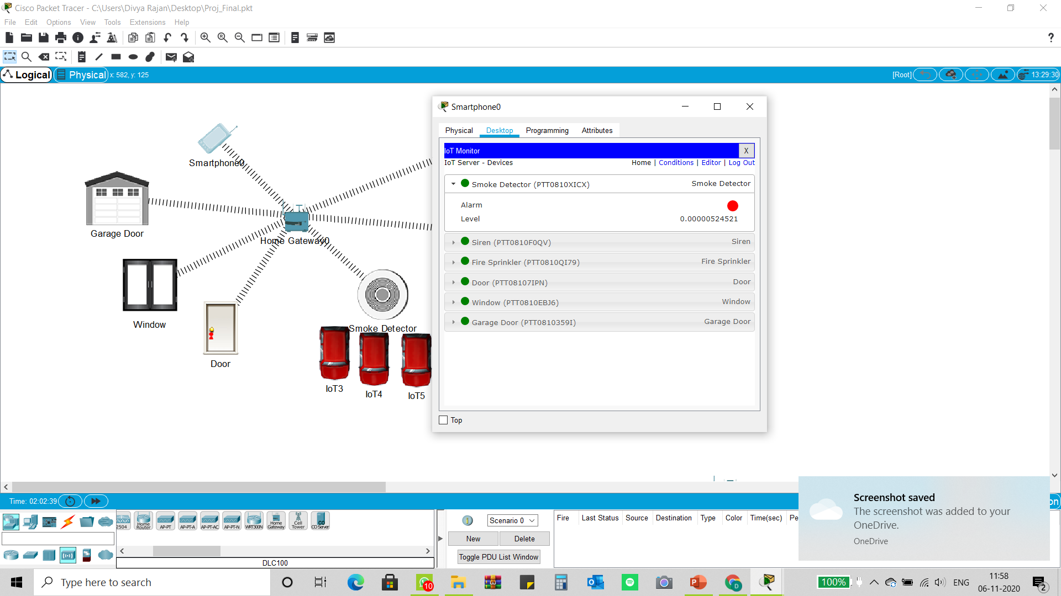

Slide 12
Algorithm / Flow Chart
The Algorithm is explained as follows
Step 1: Start the project.
Step 2: Open the pkt file and save the file.
Step 3: Add the required components to the work space as packet tracer simulator shown above.
Step 4 : Add Home Gateway to the Network
Step 5. Configure the device.
Step 6 : Connect smart Devices to the Wireless Network.
Step 7: Stop

Slide 13
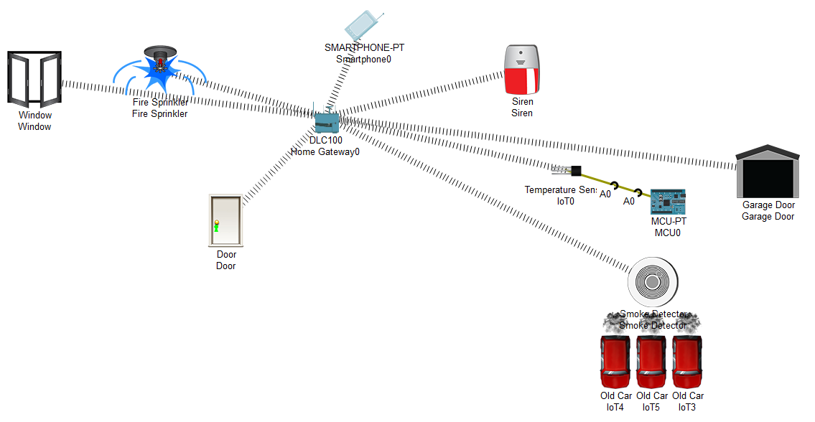
Results & Discussion

Slide 14
Advantages
1. Avoid Smoke Inhalation
2. Early Fire Detection
3. Decreased Risk of Fire Damage
4. Placement Flexibility
5. 24/7 Monitoring
6. Easy & Affordable
7. Low Maintenance

Slide 15
Conclusion & Future Scope
Conclusion
We used the Packet Tracer tools to build a smoke detecting network
with fire prevention applying a wireless connection between IoT
devices.
Future Scope
We can develop the existing system by adding certain devices such as Multidetector, Flame detector and Smartphone which makes the network
function with better efficiency, lower cost , using less area and most importantly better
safety and security.

Slide 16
References
[1] D. W. Bliss, P. A. Parker, A. R. Margetts, "Simultaneous transmission and reception for improved wireless network performance", Statistical Signal Processing 2007 IEEE/SP 14th Workshop on, pp. 478-482, 2007.
[2] thingsboard.io/docs/iot-gateway/guides/how-to-connect-ble-sensor-using-gateway
[3] IoT-Based Intelligent Modeling of Smart Home - MDPI

Slide 17
Milestones/Schedule
Milestone | Baseline Date | Target Date | Achievement
Software | 25-09-2020 | 30-09-2020 | Completed
Understanding the network connections | 30-10-2020 | 30-10-2020 | Completed
Complete Network in the software | 10-11-2020 | 10-11-2020 | Completed

Slide 18
CONTRIBUTION
NAME | CONTRIBUTION
DIVYA SHREE R | PROJECT EXECUTION POWER POINT PRESENTATION RESEARCH ON PROJECT
DEVIKA K | REPORT POWER POINT PRESENTATION RESEARCH ON PROJECT
SHARANYA K N | REPORT POWER POINT PRESENTATION RESEARCH ON PROJECT
SAHANA YELCHURI | REPORT PROJECT EXECUTION RESEARCH ON PROJECT

Slide 19
Thank You

